Slide 1


SINGLE PRECISION FLOATING POINT ALU IN VERILOG
AMAN KATIYAR
ANKIT KUMAR
ARYAN MEENA
AYUSH BANSAL
JWAL BARBHAYA

Slide 2

INTRODUCTION
LET’S INTRODUCE YOU TO OUR PROJECT

Slide 3


ARITHMETIC LOGIC UNIT(ALU)
•An arithmetic logic unit(ALU) is a combinational digital electronic circuit representing the fundamental building block of the CPU of a computer.
•It perform ADDITION, SUBTRACTION, MULTIPLICATION, DIVISION, and BITWISE logical operations like AND, OR, NOT on number in the IEEE-754 format.

Slide 4

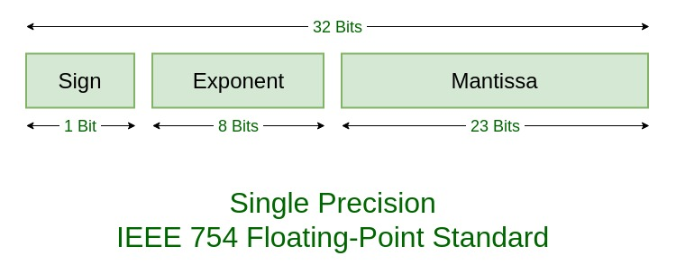
IEEE-754 FORMAT
.The IEEE-754 SINGLE PRECISION Floating point format is used to represent a large range of numbers with limited computational or storage resources.
.The numbers are stored in 32 bits, where the first bit denotes the sign, the next 8 denote the exponent, and the rest of them denote the mantissa.

Slide 5

CONVERSION OF DECIMAL TO FLOATING POINT
DECIMAL TO BINARY
MANTISSA & EXPONENT
SIGN BIT
Convert decimal to binary form.
Shift the radix point until there remail only one bit to the left.
Exponent is (127+x ) binary where x represent how many times the radix is shifted.
Mantissa is the number after the radix.
Sign bit is 0 FOR –VE NUMBER.
1 for +ve number.

Slide 6


ARCHITECTURE OF OUR DESIGN MODULE

Slide 7
ADDER –SUBSTRACTOR MODULE
This module works in 3 basic stages.
In first stage , it is pre-normalizes the operands (i.e. Prepares for the operation).
In second stage, it applies the operation to operands.
In final stage, it post the normalized output.

Slide 8
ALGORITHM OF ADDITION AND SUBTRACTION
Compare the exponents of two numbers. Shift the smaller number to the right until its exponent match the large number.
ADD/Subtract the significands according to sign bits.
Normalize the sum either shifting right and incrementing the exponent or shifting left and decrementing the exponent.
Round the significand to the appropriate number of bits and renormalize it if rounding generates a carry.
Check for Overflow or Underflow. if there is, report exception.

Slide 9
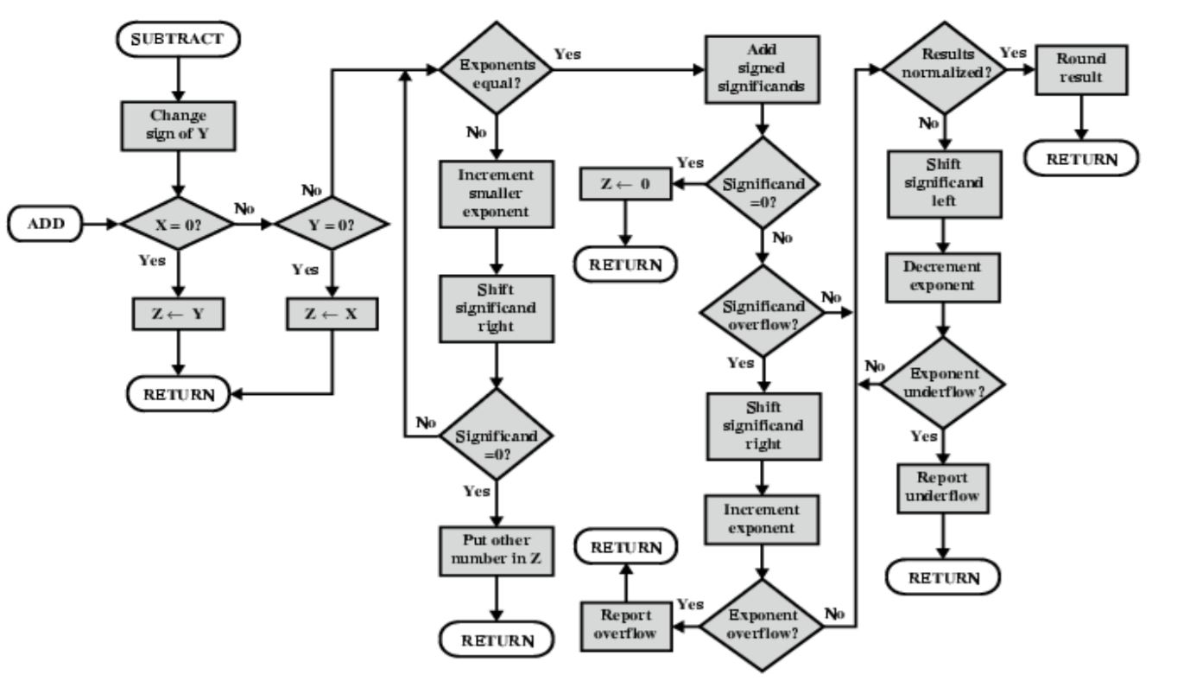
FLOW CHART FOR ADDITION & SUBTRACTION

Slide 10
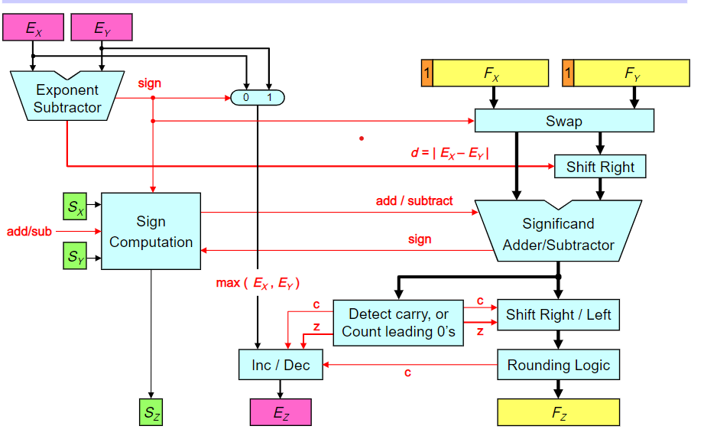
BLOCK DIAGRAM OF ADDITION AND SUBTRACTION

Slide 11
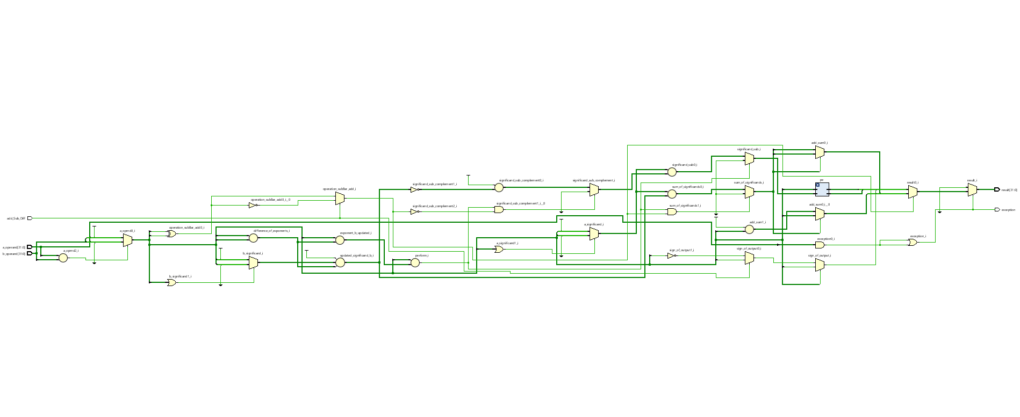
ADDER-SUBTRACTOR MODULE

Slide 12
MULTIPLICATION MODULE
Add the biased exponents of the two numbers, subtracting the bias from the sum to get the new biased exponent.
Multiply the significands. Set the result sign to positive if operands have same sign and negative otherwise.
Normalize the product if necessary, shifting its significand right and incrementing the exponent.
Round the significand to the appropriate number of bits, and renormalize if rounding generates a carry.
Check for Overflow or Underflow. if there is, report exception.

Slide 13
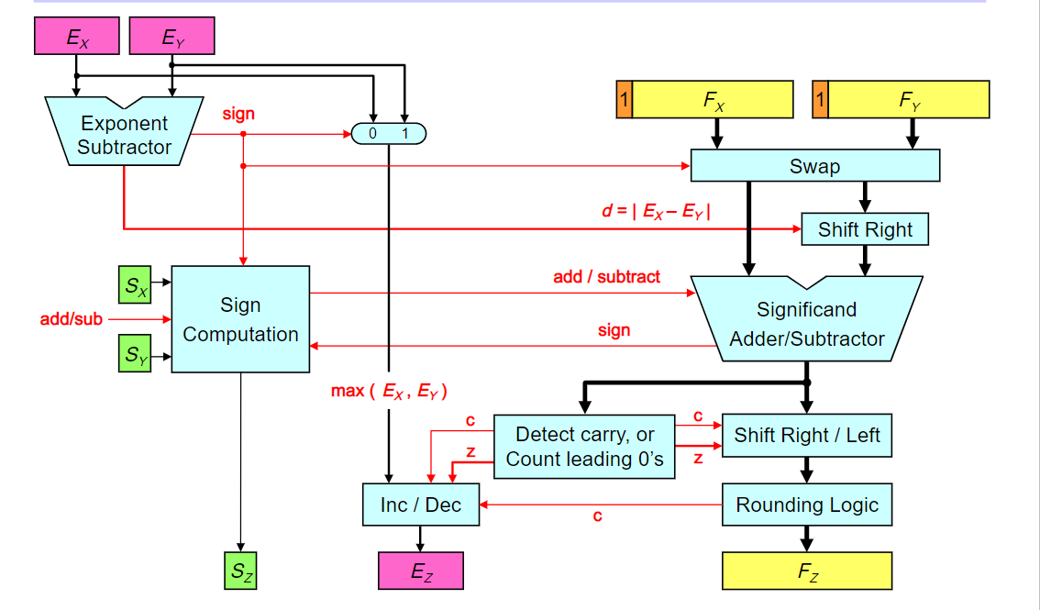
BLOCK DIAGRAM OF MULTIPLICATION

Slide 14
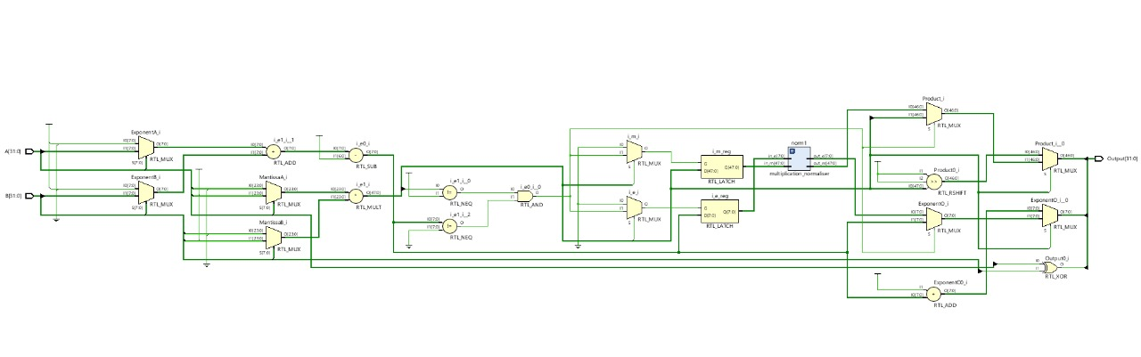
BLOCK DIAGRAM OF MULTIPLIER MODULE

Slide 15
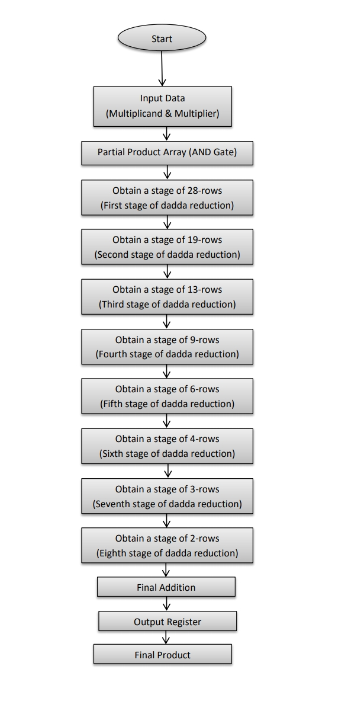
MULTIPLICATION USING DADDA MULTIPLIER

Slide 16
ALGORITHM OF DADDA MULTIPLIER
Multiply (that is - AND) each bit of one of the arguments, by each bit of the other, yielding N^2results.
Reduce the number of partial products to two layers of full and half adders. For this, Dadda reduction scheme uses the following algorithm.
Let d1 = 2 and dj+1 = [3.dj / 2], where dj is the matrix height for the j-th stage from the end. Find the largest j such that at least one column of the matrix has more than dj bits.
Employ (3, 2) and (2, 2) counters to obtain a reduced matrix with no more than dj elements in any column.
Until a matrix with only two rows is generated. Let j = j-1 and repeat step b
Group the wires in two numbers, and add them with a conventional adder

Slide 17

DIVISION MODULE
the division module works on the algorithm of Newton-Raphson for finding multiplicative inverse.
We first shift the dividend by 1 bit towards left then we subtract the divisor.
Same procedure we do 24 times.
Then we check for overflow, if exponent overflow is there, we report as overflow
Else we check for underflow, if there is underflow then we report as underflow.
If there is no overflow and underflow then we divide mantissas and determines the sign of the result.
If necessary , normalize the resulting value.

Slide 18
ALGORITHM OF DIVISION
Check for zero if numerator is zero return zero if denominator is zero return error
If both the numbers are non zero subtract the exponents of both the numbers using 2’s complementing method (discard the carry if occur)and add 127 to them for exponent part
Check for exponent overflow. if exponent overflow is there report overflow
if no exponent overflow is there check for underflow if there is underflow then report underflow
if no underflow and overflow is there then divide mantissas and determine the sign of the result
Normalize the resulting value, if necessary.

Slide 19
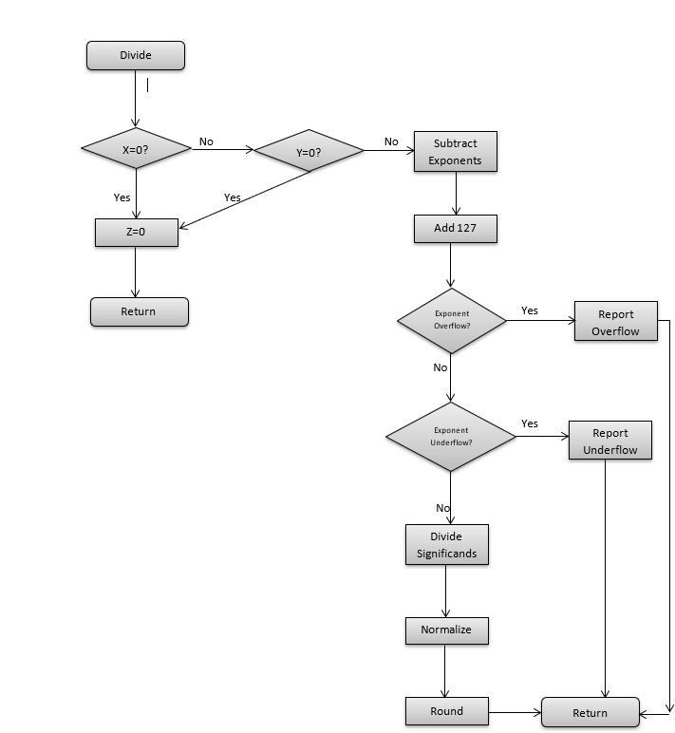
FLOWCHART OF DIVISION

Slide 20
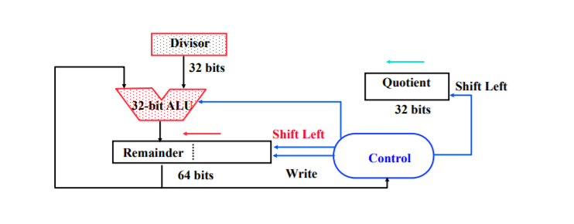
BLOCK DIAGRAM OF DIVISION

Slide 21
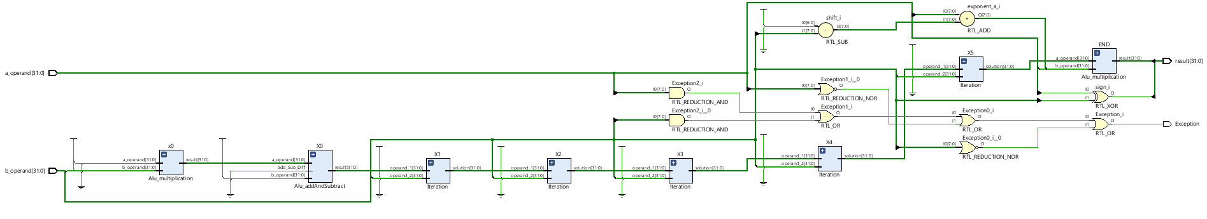
DIVISION MODULE

Slide 22
COMPLETE ALU

Slide 23
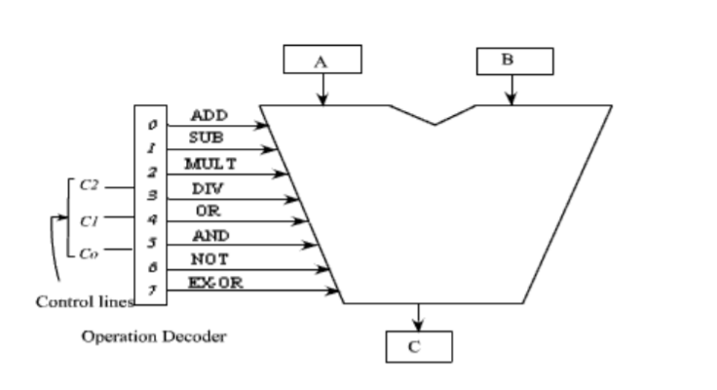
BLOCK DIAGRAM OF ALU
ALU CONTROL OPERATION
000 ADD OPERAND “A” AND “B”
001 SUBTRACT OPERANDS “A” AND “B”
010 MULTIPLY OPERANDS “A” AND “B”
011 DIVIDE OPERANDS “A” AND “B”
100 LOGICALLY OR OPERAND “A” AND “B”
101 LOGICALLY AND OPERAND “A” AND “B”
110 LOGICALLY NOT OPERAND “A”
111 LOGICALLY EX-OR OPERAND “A” AND “B”

Slide 24
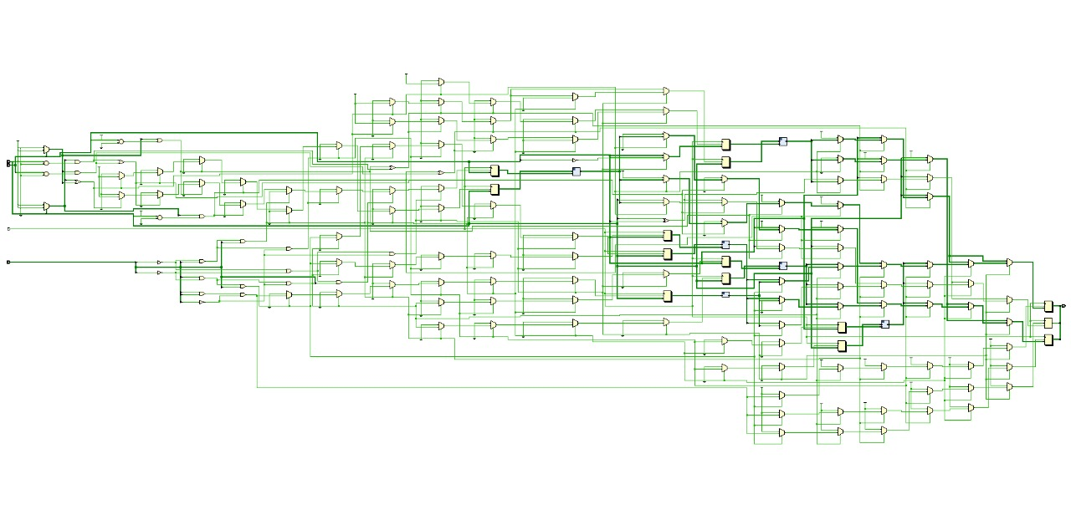
BLOCK DIAGRAM OF COMPLETE ALU MODULE

Slide 25
SIMULATION RESULT & WAVEFORM

Slide 26
ACCURACY RESULT OF TEST BENCHES
OPERATION | TOTAL NO. OF TEST CASE | TOTAL NO. OF TEST CASE PASSED | TOTAL N0. OF TEST CASE FAILED | ACCURACY
Addition | 100 | 86 | 14 | 86%
Subtraction | 100 | 82 | 18 | 82%
Multiplication | 96(randomly) | 92 | 4 | 95.83%
Division | 78 | 53 | 25 | 67.79%
Bitwise OR | 105 | 105 | 0 | 100%
Bitwise And | 105 | 105 | 0 | 100%
Bitwise Not | 105 | 105 | 0 | 100%
Bitwise XOR | 50 | 50 | 0 | 100%

Slide 27
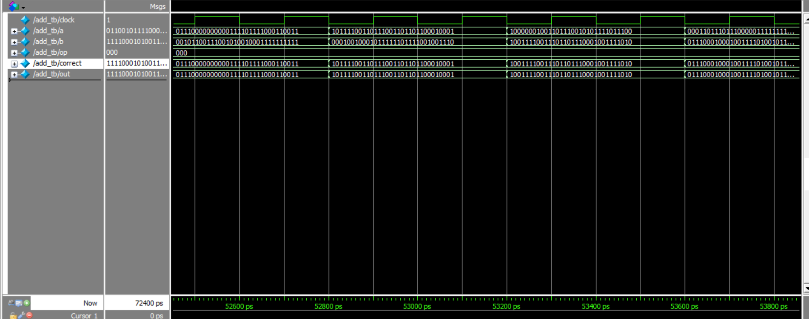
ADDITION WAVEFORM

Slide 28
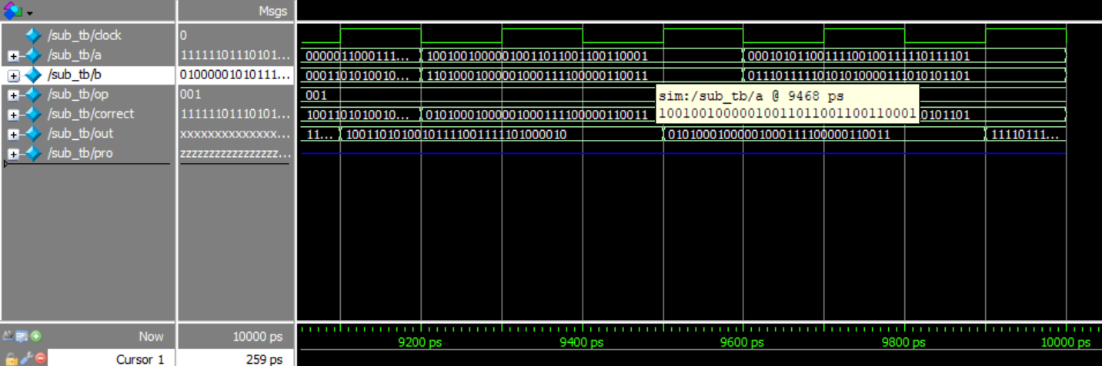
SUBTRACTION WAVEFORM

Slide 29
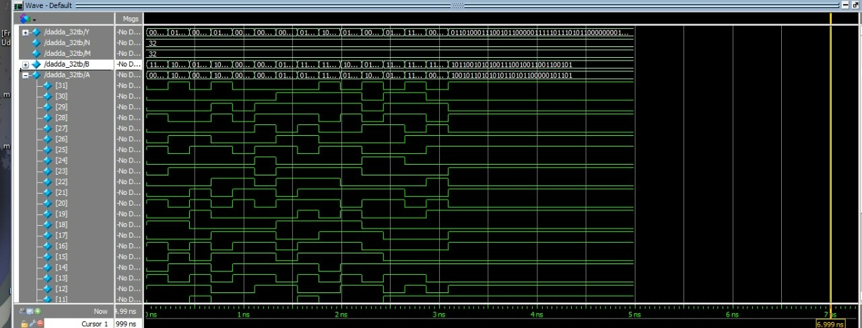
MULTIPLICATION WAVEFORM

Slide 30
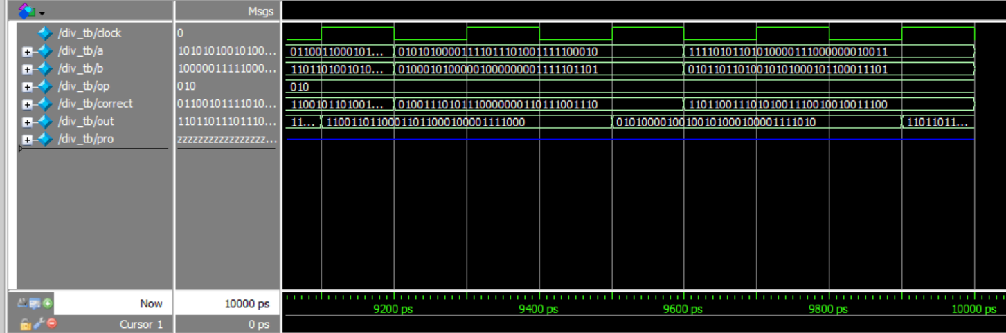
DIVISION WAVEFORM
PLEASE WRITE HERE

Slide 31
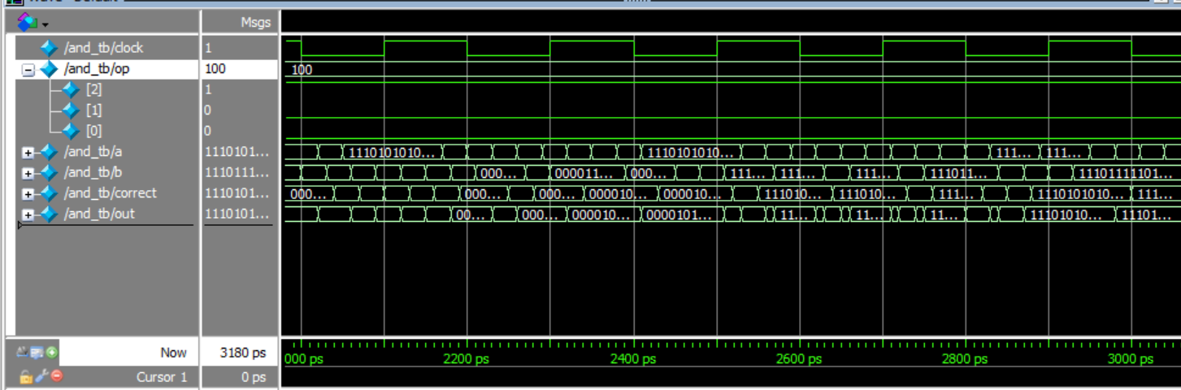
BITWISE AND WAVEFORM

Slide 32
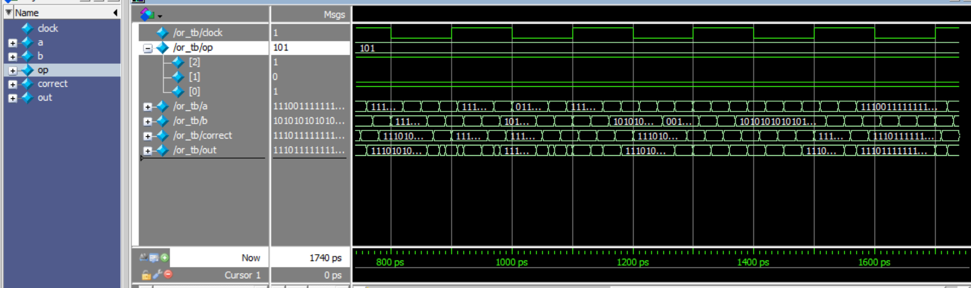
BITWISE OR WAVEFORM

Slide 33
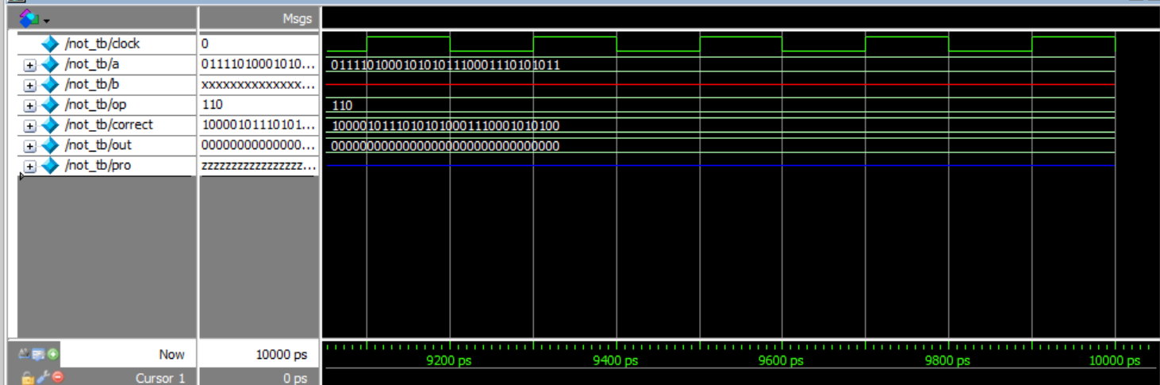
BITWISE NOT WAVEFORM
H

Slide 34
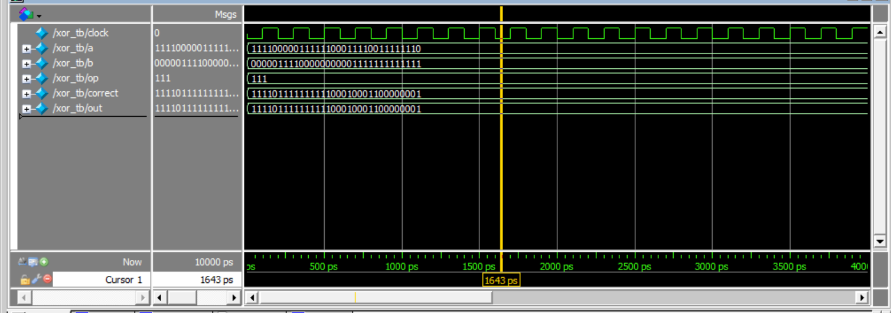
BITWISE XOR WAVEFORM

Slide 35
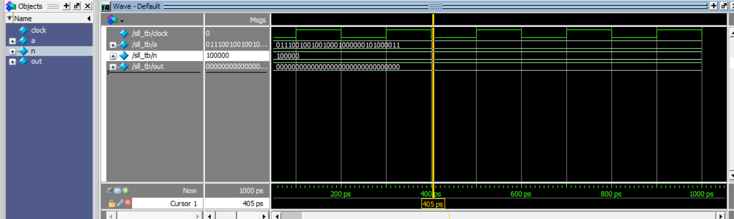
SLL WAVEFORM

Slide 36
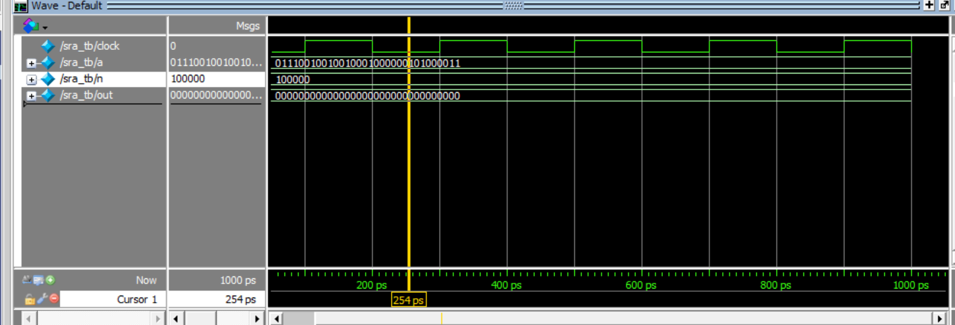
SRA WAVEFORM
H

Slide 37
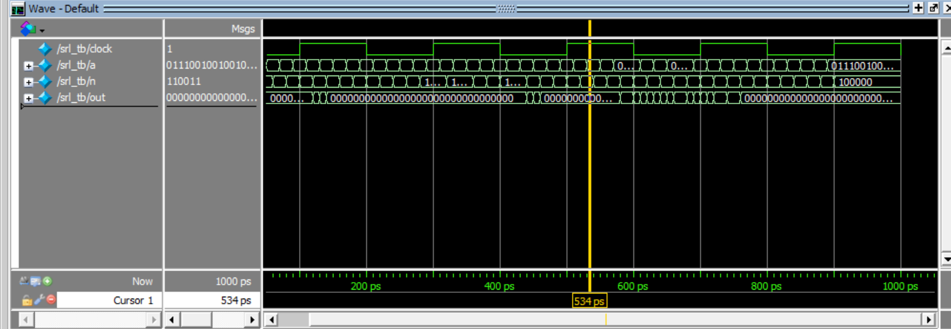
SRL WAVEFORM

Slide 38
MAJOR CHALLENGES FACED

Slide 39
Gathering information of Verilog is one of major task.
Due to pandemic there is difficulty while discussing the project with team members.
Due to limited data and other resources , the team lacked the facilities.
Due to limited data, few of team member can’t able to download vivado therefore we have to look for alternative option which was not as advance as vivado.
Novice errors while writing the verilog code due to lots of compiler error.
Problem of underflow and overflow troubled us while writing multiplication and division module .

Slide 40

PROJECT TEAM MEMBER

Slide 41
ANKIT KUMAR 20112015
AMAN KATIYAR 201160O6
ARYAN MEENA 20116019
AYUSH BANSAL 20116022
JWAL BARBHAYA 20116024
H

Slide 42
CONCLUSION

Slide 43
Floating-point single-precision ALU has been discussed and analysis extensively by our group member.
Partwise suitable algorithm has been developed all arithmetic and logic operation.
Design module has been tested extensively for randomly generated test bench and we got good amount of accuracy of it.
Proper time has been devoted to make the algorithm efficient.

Slide 44




